Slide 1
Constraint Satisfaction, Part 2 Lecture 12 Chapter 6, Sections 6.1-6.3
Jim Rehg
College of Computing
Georgia Tech
February 8, 2016

Slide 2
Ways to Improve Backtracking Search
What variable to assign next?
Choose variable with fewest values left → fail first
What order to use for values of a variable?
Choose val that leaves most options for remaining vars → fail last
What inferences can be made from an assignment?
How can we take advantage of problem structure?

Slide 3
Minimum Remaining Values (MRV)
Choose the variable with the fewest remaining legal values
NT
Q
WA
SA
NSW
V

Slide 4
Least Constraining Value
Choose the value which removes the least number of potential values from the remaining unassigned variables
Choosing Q=red leaves
1 value for SA,
while Q=blue would leave
0 values
NT
Q
WA
SA
NSW
V
Notes:
Once we have expanded to a particular variable at a given depth, we would like to go deeper to see if we can find a solution along the path we are on, since we only care about getting to a single solution quickly. The choice of Least Constraining Value keeps the search alive by giving future variables the most options. In contrast, in choosing variables to expand, we can reduce the branching factor of the tree by pruning branches early, and thus we use MRV for variable selection.

Slide 5
Ways to Improve Backtracking Search
What variable to assign next?
Choose variable with fewest values left → fail first
What order to use for values of a variable?
Choose val that leaves most options for remaining vars → fail last
What inferences can be made from an assignment?
Constraint propagation to reduce the legal values for variables
How can we take advantage of problem structure?

Slide 6
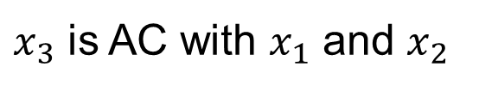
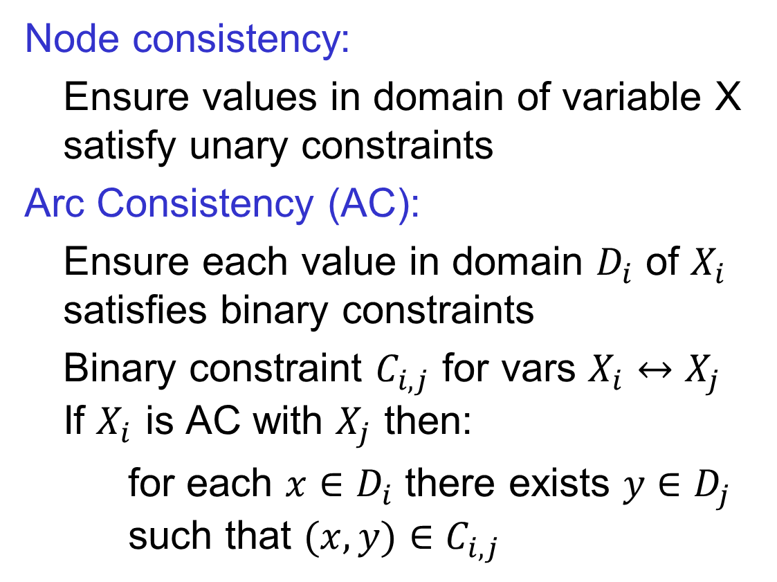
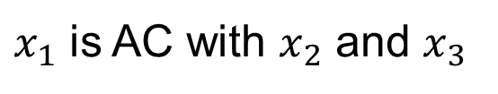



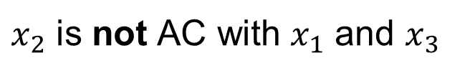
Checking Consistency
Node consistency:
Ensure values in domain of variable X satisfy unary constraints
Arc Consistency (AC):
Ensure each value in domain $D_{i}$ of $X_{i}$ satisfies binary constraints
Binary constraint $C_{i,j}$ for vars $X_{i}↔X_{j}$ If $X_{i}$ is AC with $X_{j}$ then:
for each $x∈D_{i}$ there exists $y∈D_{j}$ such that $(x,y)∈C_{i,j}$
$$x_{2}$$
$$x_{1}$$
$$x_{3}$$
$x_{1}$ is AC with $x_{2}$ and $x_{3}$
$x_{3}$ is AC with $x_{1}$ and $x_{2}$
$x_{2}$ is not AC with $x_{1}$ and $x_{3}$
Notes:
x_1 is AC: for x_1 = R choose x_2 = G or B and x_3 = B
x_3 is AC: for x_3 = B choose x_1 = R and x_2 = R or G
x_2 is not AC: for x_2 = R there is no valid choice for x_1 and for x_2 = B there is no valid choice for x_3
Note that in this case arc consistency is a property which a set of variables with domains either possesses or doesn’t
There is also a process for making a set of domains arc consistent, which (confusingly) is also sometimes referred to as arc consistency
We will refer to the process of enforcing consistency as AC-3, a classical arc consistency algorithm, so as to avoid confusion.
In this example, AC-3 would remove the R and B values from the domain of x_2, thereby rendering the variables arc consistent.

Slide 7

Forward Checking
Whenever a variable $X$ is assigned, enforce arc consistency for all links $Y→X$ for unassigned variables $Y$
WA | NT | NSW | Q | SA | V
But we could have identified
it here!
WA | NT | NSW | Q | SA | V
NT
Q
WA | NT | NSW | Q | SA | V
WA
SA
NSW
No valid assignment!
V

Slide 8

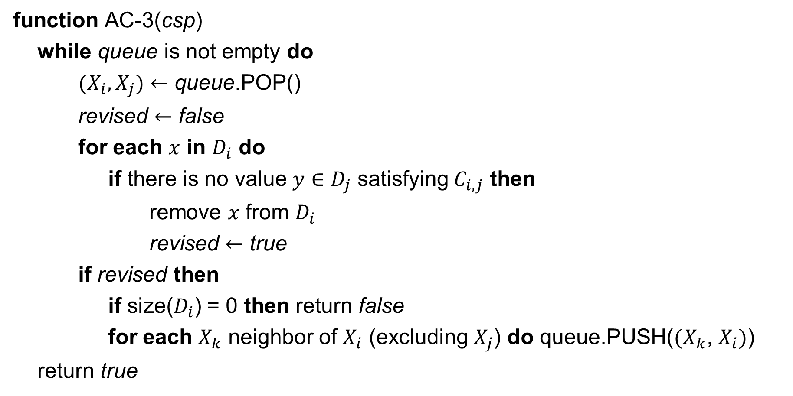
Recursively Enforcing Arc Consistency
function AC-3(csp)
while queue is not empty do
${(X}_{i},X_{j})←$ queue.POP()
revised $←$ false
for each $x$ in $D_{i}$ do
if there is no value $y∈D_{j}$ satisfying $C_{i,j}$ then
remove $x$ from $D_{i}$
revised $←$ true
if revised then
if size($D_{i}$) = 0 then return false
for each $X_{k}$ neighbor of $X_{i}$ (excluding $X_{j}$) do queue.PUSH(${(X}_{k}$, $X_{i})$)
return true
Alan Mackworth
Univ. of British Columbia
Goes beyond forward checking by propagating constraints

Slide 9





AC-3 Map Coloring Example
Queue
$X_{1}→X_{2}$
$X_{2}→X_{1}$
$X_{2}→X_{3}$
$⋮$
$$x_{4}$$
$$x_{2}$$
$$x_{1}$$
$$x_{3}$$

Slide 10


AC-3 Map Coloring Example
Queue
$X_{1}→X_{2}$
$X_{2}→X_{1}$
$X_{2}→X_{3}$
$⋮$
$$x_{4}$$
$$x_{2}$$
When you set $x_{1}=red$ you
can choose $x_{2}=blue$ to
satisfy constraint
$$x_{1}$$
$$x_{3}$$

Slide 11
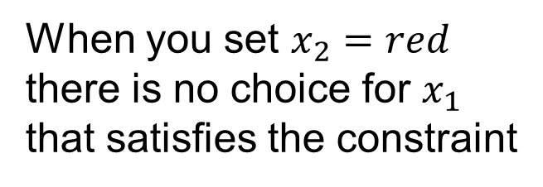

AC-3 Map Coloring Example
Queue
$X_{1}→X_{2}$
$X_{2}→X_{1}$
$X_{2}→X_{3}$
$⋮$
$$x_{4}$$
When you set $x_{2}=red$
there is no choice for $x_{1}$
that satisfies the constraint
$$x_{2}$$
$$x_{1}$$
$$x_{3}$$

Slide 12

AC-3 Map Coloring Example
Queue
$X_{1}→X_{2}$
$X_{2}→X_{1}$ remove
$X_{2}→X_{3}$
$⋮$
$$x_{4}$$
$$x_{2}$$
$$x_{1}$$
$$x_{3}$$

Slide 13
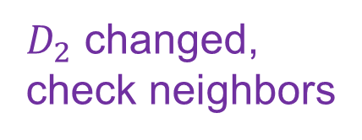

AC-3 Map Coloring Example
Queue
$X_{3}→X_{2}$
$X_{4}→X_{2}$
$X_{2}→X_{3}$
$⋮$
$$x_{4}$$
$D_{2}$ changed, check neighbors
$$x_{2}$$
$$x_{1}$$
$$x_{3}$$

Slide 14
AC-3 Map Coloring Example
Queue
$X_{3}→X_{2}$
$X_{4}→X_{2}$
$X_{2}→X_{3}$
$⋮$
$$x_{4}$$
$D_{2}$ changed, check neighbors
$$x_{2}$$
$$x_{1}$$
$$x_{3}$$

Slide 15

AC-3 Map Coloring Example
Queue
$X_{2}→X_{3}$
$⋮$
$$x_{4}$$
$$x_{2}$$
$$x_{1}$$
$$x_{3}$$

Slide 16

AC-3 Map Coloring Example
Queue
$X_{2}→X_{3}$ remove
$⋮$
$$x_{4}$$
$$x_{2}$$
$$x_{1}$$
$$x_{3}$$

Slide 17

AC-3 Map Coloring Example
Queue
$X_{4}→X_{2}$
$X_{1}→X_{2}$
$⋮$
$$x_{4}$$
$$x_{2}$$
$$x_{1}$$
$$x_{3}$$

Slide 18

AC-3 Map Coloring Example
Queue
$X_{4}→X_{2}$ remove
$X_{1}→X_{2}$
$⋮$
$$x_{4}$$
$$x_{2}$$
$$x_{1}$$
$$x_{3}$$

Slide 19
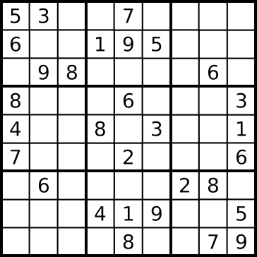
AC-3 Sudoku Example
Domain: {1,2,3,4,5,6,7,8,9}
Propagate box constraint
Domain: {1,2,3,4,5, 7,8,9}
Propagate row constraint
Domain: { 2,3, 7,8 }
Propagate column constraint
Domain: { 2,3, 7 }

Slide 20
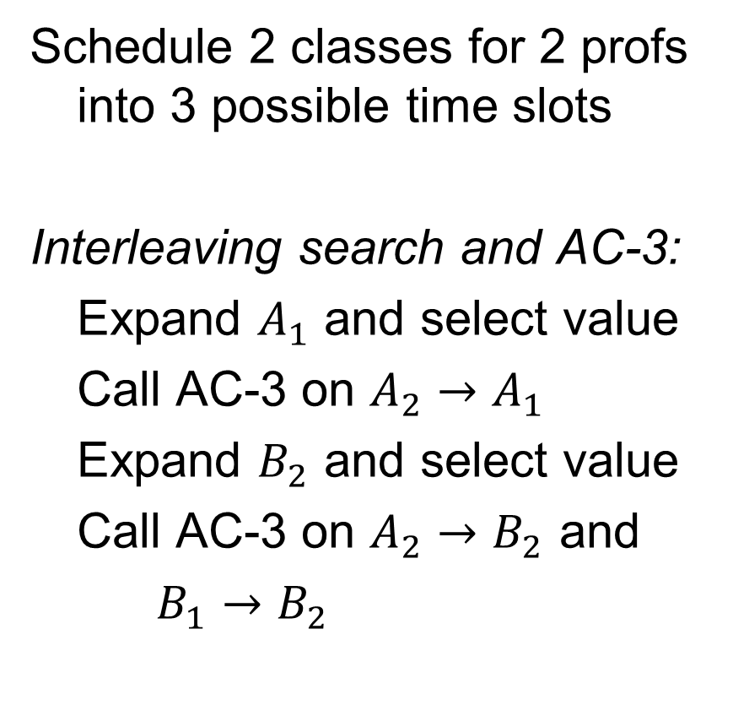
Constraint Propagation Example
Schedule 2 classes for 2 profs into 3 possible time slots
Interleaving search and AC-3:
Expand $A_{1}$ and select value
Call AC-3 on $A_{2}→A_{1}$
Expand $B_{2}$ and select value
Call AC-3 on $A_{2}→B_{2}$ and
$B_{1}→B_{2}$
$$A_{1}$$
$$\{10,11,12\}$$
$$B_{1}$$
$$\{10,11,12\}$$
$$≠$$
$$≠$$
$$=$$
$$A_{2}$$
$$B_{2}$$
$$\{10,11,12\}$$
$$\{10,11,12\}$$
Notes:
This is a version of the backtracking search algorithm where the INFERENCE step calls AC-3. Your book calls this method Maintaining Arc Consistency (see p. 218)

Slide 21
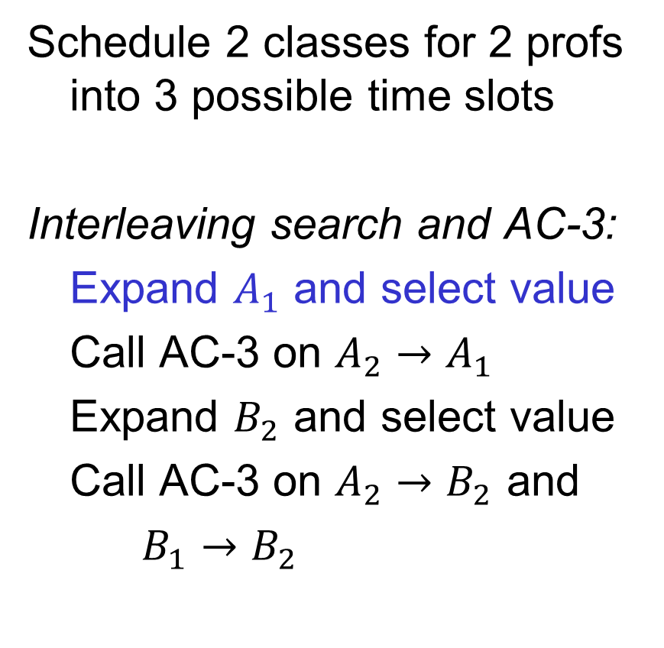

Constraint Propagation Example
Schedule 2 classes for 2 profs into 3 possible time slots
Interleaving search and AC-3:
Expand $A_{1}$ and select value
Call AC-3 on $A_{2}→A_{1}$
Expand $B_{2}$ and select value
Call AC-3 on $A_{2}→B_{2}$ and
$B_{1}→B_{2}$
$$A_{1}$$
$$\{10\}$$
$$B_{1}$$
$$\{10,11,12\}$$
$$≠$$
$$≠$$
$$=$$
$$A_{2}$$
$$B_{2}$$
$$\{10,11,12\}$$
$$\{10,11,12\}$$

Slide 22
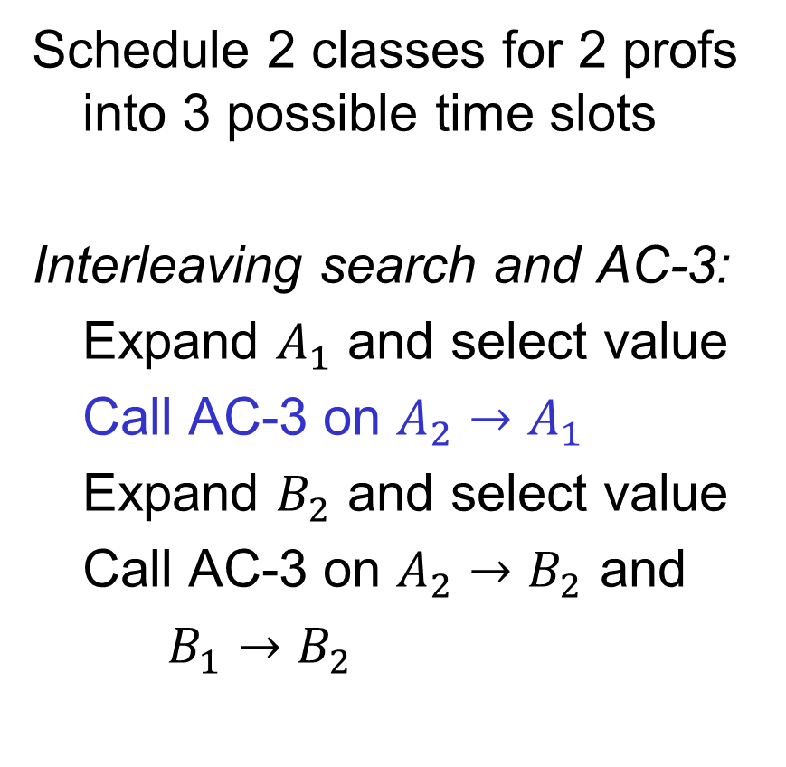
Constraint Propagation Example
Schedule 2 classes for 2 profs into 3 possible time slots
Interleaving search and AC-3:
Expand $A_{1}$ and select value
Call AC-3 on $A_{2}→A_{1}$
Expand $B_{2}$ and select value
Call AC-3 on $A_{2}→B_{2}$ and
$B_{1}→B_{2}$
$$A_{1}$$
$$\{10\}$$
$$B_{1}$$
$$\{10,11,12\}$$
$$≠$$
$$≠$$
$$=$$
$$A_{2}$$
$$B_{2}$$
$$\{10,11,12\}$$
$$\{10,11,12\}$$

Slide 23

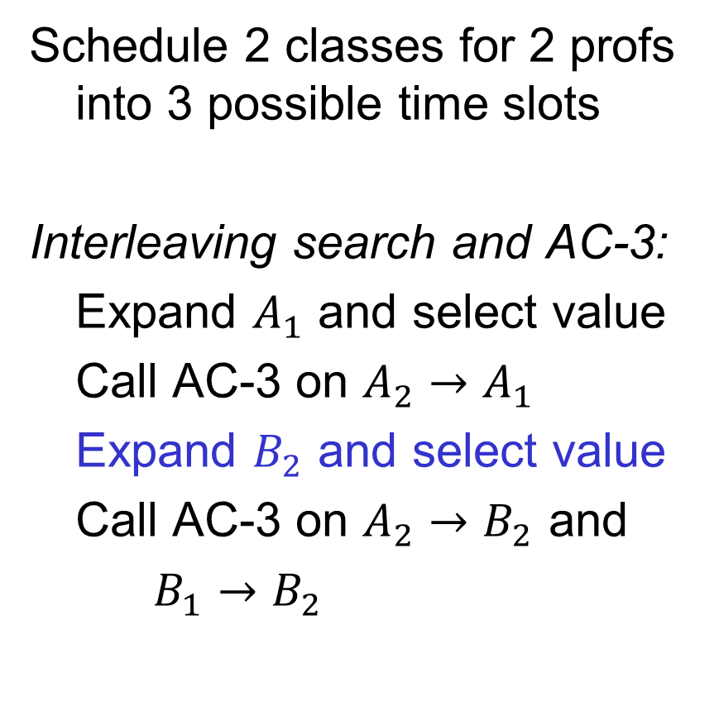
Constraint Propagation Example
Schedule 2 classes for 2 profs into 3 possible time slots
Interleaving search and AC-3:
Expand $A_{1}$ and select value
Call AC-3 on $A_{2}→A_{1}$
Expand $B_{2}$ and select value
Call AC-3 on $A_{2}→B_{2}$ and
$B_{1}→B_{2}$
$$A_{1}$$
$$\{10\}$$
$$B_{1}$$
$$\{10,11,12\}$$
$$≠$$
$$≠$$
$$=$$
$$A_{2}$$
$$B_{2}$$
$$\{10,11,12\}$$
$$\{11\}$$

Slide 24
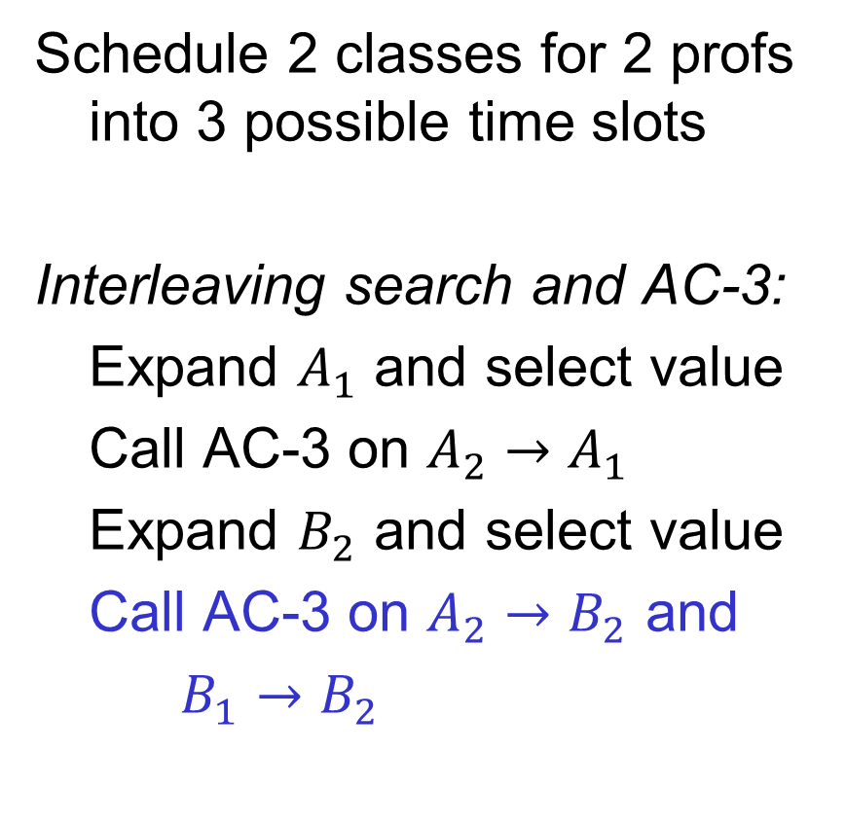
Constraint Propagation Example
Schedule 2 classes for 2 profs into 3 possible time slots
Interleaving search and AC-3:
Expand $A_{1}$ and select value
Call AC-3 on $A_{2}→A_{1}$
Expand $B_{2}$ and select value
Call AC-3 on $A_{2}→B_{2}$ and
$B_{1}→B_{2}$
$$A_{1}$$
$$\{10\}$$
$$B_{1}$$
$$\{10,11,12\}$$
$$≠$$
$$≠$$
$$=$$
$$A_{2}$$
$$B_{2}$$
$$\{10,11,12\}$$
$$\{11\}$$

Slide 25


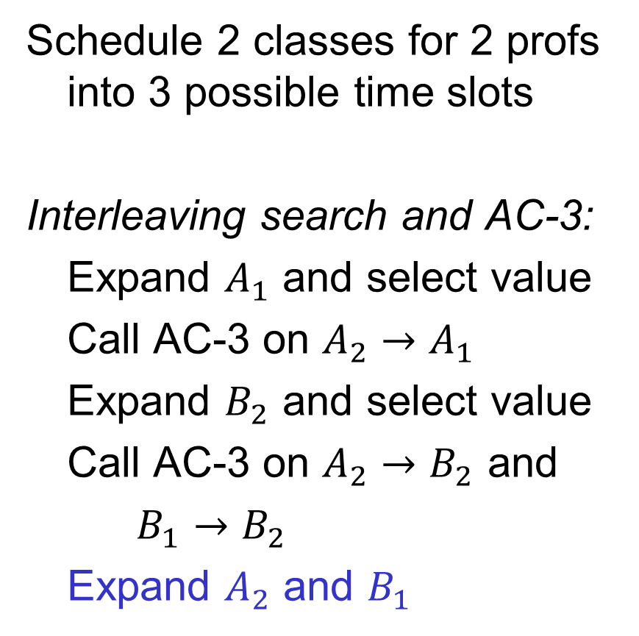
Constraint Propagation Example
Schedule 2 classes for 2 profs into 3 possible time slots
Interleaving search and AC-3:
Expand $A_{1}$ and select value
Call AC-3 on $A_{2}→A_{1}$
Expand $B_{2}$ and select value
Call AC-3 on $A_{2}→B_{2}$ and
$B_{1}→B_{2}$
Expand $A_{2}$ and $B_{1}$
$$A_{1}$$
$$\{10\}$$
$$B_{1}$$
$$\{12\}$$
$$≠$$
$$≠$$
$$=$$
$$A_{2}$$
$$B_{2}$$
$$\{11\}$$
$$\{11\}$$
Notes:
Note that in the final step there are two choices left for B_1 that both satisfy the constraints, so you can choose either one

Slide 26
Ways to Improve Backtracking Search
What variable to assign next?
Choose variable with fewest values left → fail first
What order to use for values of a variable?
Choose val that leaves most options for remaining vars → fail last
What inferences can be made from an assignment?
Constraint propagation to reduce the legal values for variables
How can we take advantage of problem structure?
Cutset conditioning and tree-structured CSPs

Slide 27
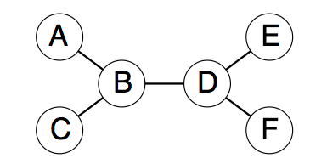

Tree-Structured CSPs
If the constraint graph has no loops (also called cycles), then
the CSP can be solved in $O(nd^{2})$ time (vs $O(d^{n})$ in general)

Slide 28
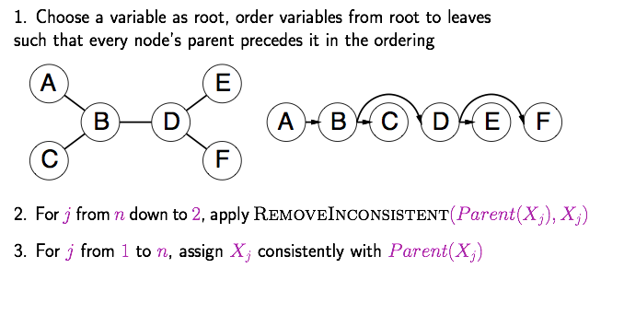
Solving Tree-Structured CSPs

Slide 29

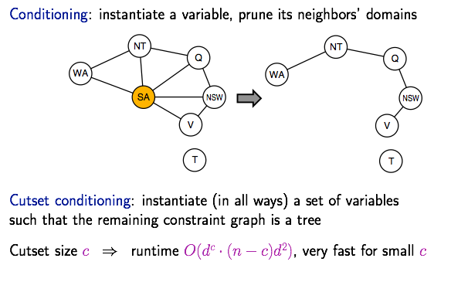
Cutset Conditioning
Rina Dechter
Univ. of California, Irvine

Slide 30
Summary
Node and arc consistency refer to whether the domains for a set of variables satisfy the constraints
Forward checking enforces arc consistency for all neighbors of a variable that has been assigned during search
Constraint propagation goes further and enforces arc consistency recursively until all domains are consistent (AC-3 algorithm)
The Maintaining Arc Consistency version of backtracking search calls AC-3 after each variable assignment
Tree-structured graphs can be solved orders of magnitude faster than general graphs. Cutset conditioning can be used with graphs that are “close” to trees

Slide 31
Questions?

